Slide 1
Security Innovation & Startup

Slide 2

ALIENVAULT OTX
Open Threat Exchange (OTX): The history and future of open threat intelligence community

Slide 3
PRESENTATION OVERVIEW
A very quick overview of AlienVault
Our Open approach to crowd sourced threat intelligence
The OTX Platform and Data

Slide 4
ABOUT ALIENVAULT
AlienVault is the leading provider of Unified Security Management (USM) and crowd-sourced threat intelligence technology required to detect and act on today’s advanced cyber threats

Slide 5






USM PLATFORM
5 CRITICAL CAPABILITIES
SECURITY INTELLIGENCE/SIEM
SIEM Event Correlation
Incident Response
ASSET DISCOVERY
Active Network Scanning
Passive Network Scanning
Asset Inventory
Host-based Software Inventory
BEHAVIORAL MONITORING
Log Collection
Netflow Analysis
Service Availability Monitoring
powered by AV Labs Threat
Intelligence
VULNERABILITY ASSESSMENT
Continuous Vulnerability Monitoring
Authenticated / Unauthenticated Active Scanning
THREAT DETECTION
Network IDS
Host IDS
File Integrity Monitoring

Slide 6
THE ATTACKER’S ADVANTAGE
They only need to be successful once
Determined, skilled and often funded adversaries
Custom malware, 0days, multiple attack vectors, social engineering
Persistent

Slide 7
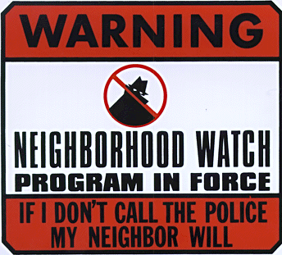

Importance of sharing
“In the case of threat-intelligence sharing, the adversary has only to mess up once – being detected – and all the defenders will know about it. It’s in our best interest, as an industry, to keep the odds ever in our favor.”
-- Wendy Nather, 451 Group, 2014 Threat Intelligence Report
Helps you to achieve a preventative response to changes in the threat landscape by learning how attackers are targeting others
Armed with real-time, detailed security event information, you can update your defenses to avoid becoming a victim
The right solution will allow you to automatically share anonymized threat information

Slide 8
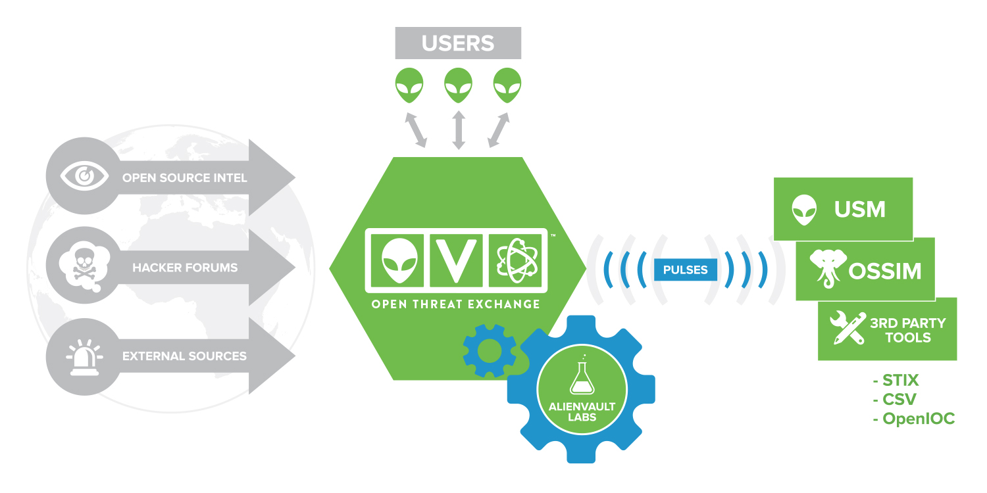
Open threat exchange
OTX
Launched in 2012 - The world’s largest open threat sharing and analysis network
Supports more than 26,000 participants in over 140 countries contributing more than 1 million threat indicators daily
Provides access to real-time, detailed information about threats and incidents around the world

Slide 9
Collaboration
powering OTX
Collaborate
Openly research and collaborate on emerging threats.
Defend
Integrate with AlienVault USM or Export IoCs to any security product
Learn
Extract, validate and investigate threat data from logs, blogs, articles and reports
)

Slide 10


The defender’s dilemma
First Street
Credit Union
Alpha Insurance
Group
John Elway
Auto Nation
Zero Cool
Telecom
Soylent Green Foods

Slide 11

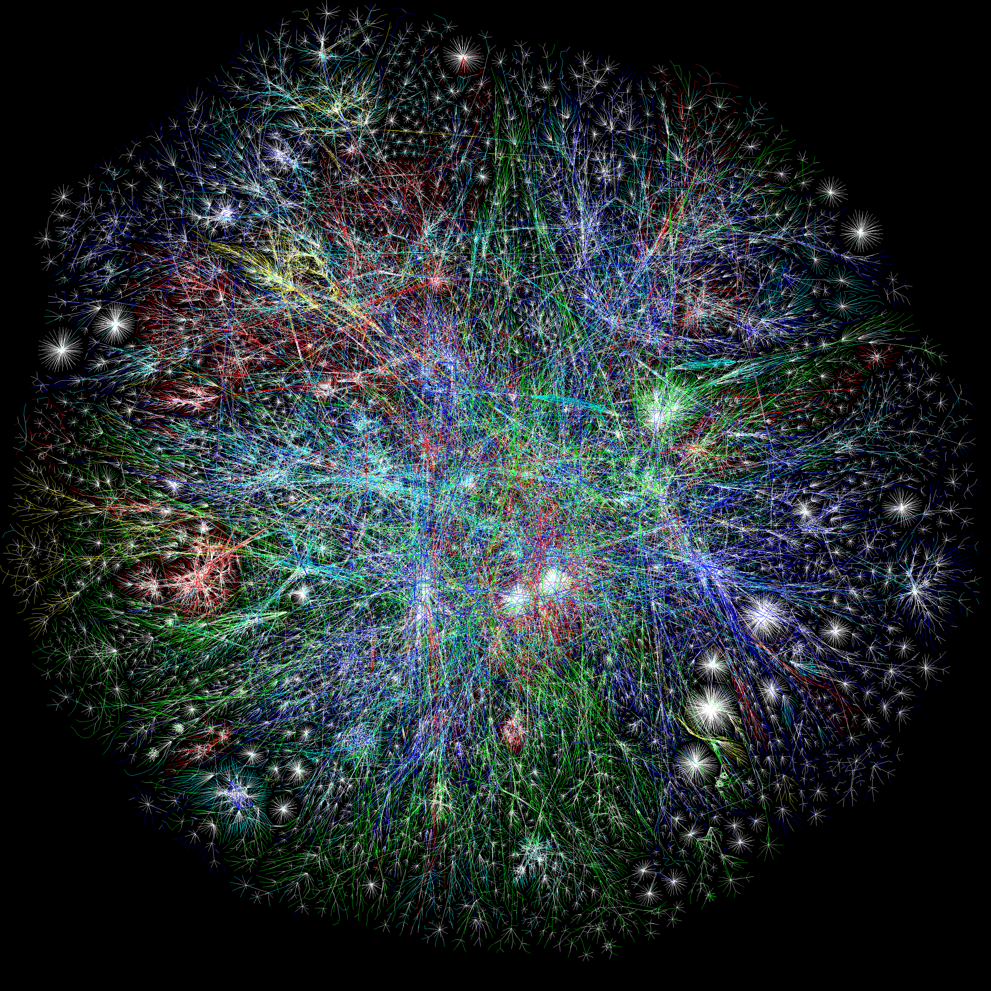

Threat intelligence applied
Intelligence improves the defender’s odds
First Street
Credit Union
Alpha Insurance
Group
John Elway
Auto Nation
Zero Cool
Telecom
Soylent Green Foods
Detect
Open Threat Exchange

Slide 12
Threat intelligence applied
Discovery improves odds for other defenders
First Street
Credit Union
Alpha Insurance
Group
John Elway
Auto Nation
Zero Cool
Telecom
Soylent Green Foods
Detect
Open Threat Exchange

Slide 13
OTX 1.0
IP reputation data
Updates provided every 30 minutes
200,000-350,000 validated malicious IP’s at any point
 | Malware Domain Distributing malware or hosting exploit code
 | Malware IP Instrumental in malware, including malicious redirection
 | Command and Control Sending command and control instructions to malware or a botnet
 | Scanning Host Observed repeatedly scanning or probing remote systems
 | APT Observed to be actively involved in an APT campaign
 | Spamming Host Actively propagating or instrumental in the distribution of spam
 | Malicious Host Engaged in malicious but uncharacterized activity

Slide 14
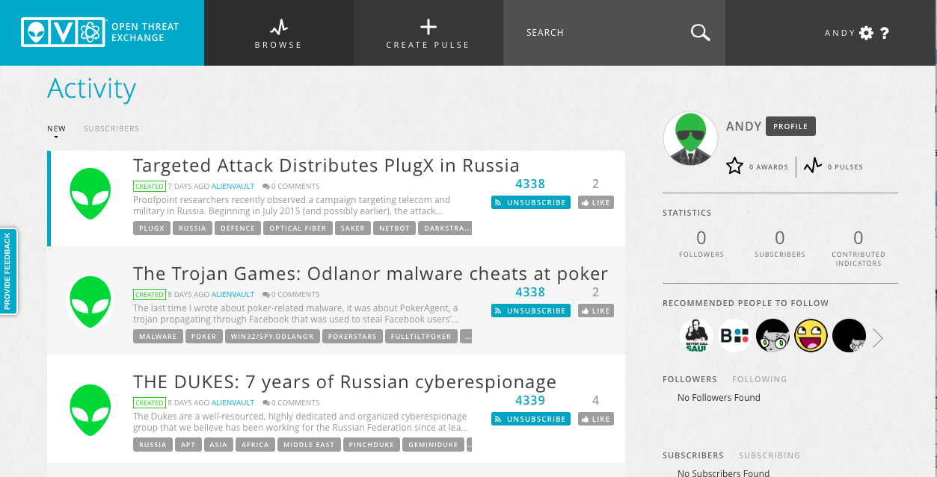
Otx 2.0: “Pulses”
Crowd sourced threat research
The face of OTX – social interface to collaboratively develop & share threat intelligence in real-time
Create, enhance or consume “pulses” – short multivariate analysis of threat indicators
Export Indicators of Compromise into security tools (OpenIOC, STIX) and automatically consume in AlienVault products
INTEGRATE & EXPLORE THROUGH AN OPEN API
Strengthen defenses and help others do the same

Slide 15
INVESTIGATING THREATS
Pulse: ONE data construct for ALL types of threats (Data breach, Botnet, APT Campaign, etc.)
Defined by Indicators of Compromise or IoCs: (md5, IPv4s, URLs, hostnames, etc.)
Explore attack vectors and threat geolocation information
Share and comment on Pulses and IoCs

Slide 16
OTX HOme PAGE

Slide 17
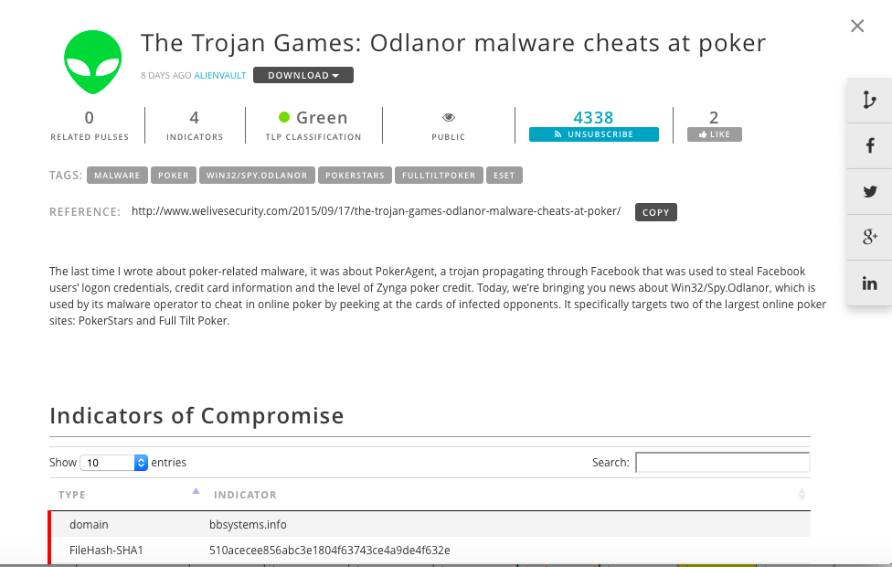
DETAILED INTELLIGENCE

Slide 18
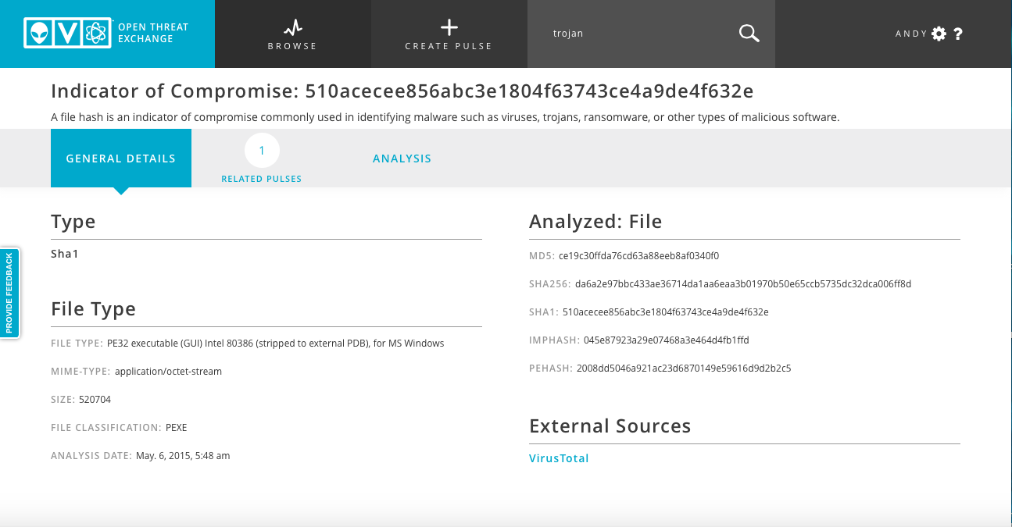
ADDITIONAL DETAIL

Slide 19
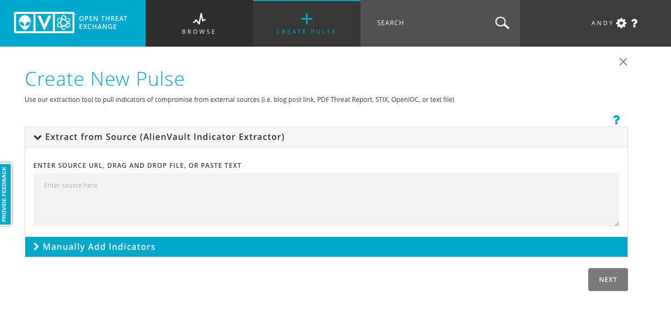
CREATING A PULSE
FROM source file

Slide 20
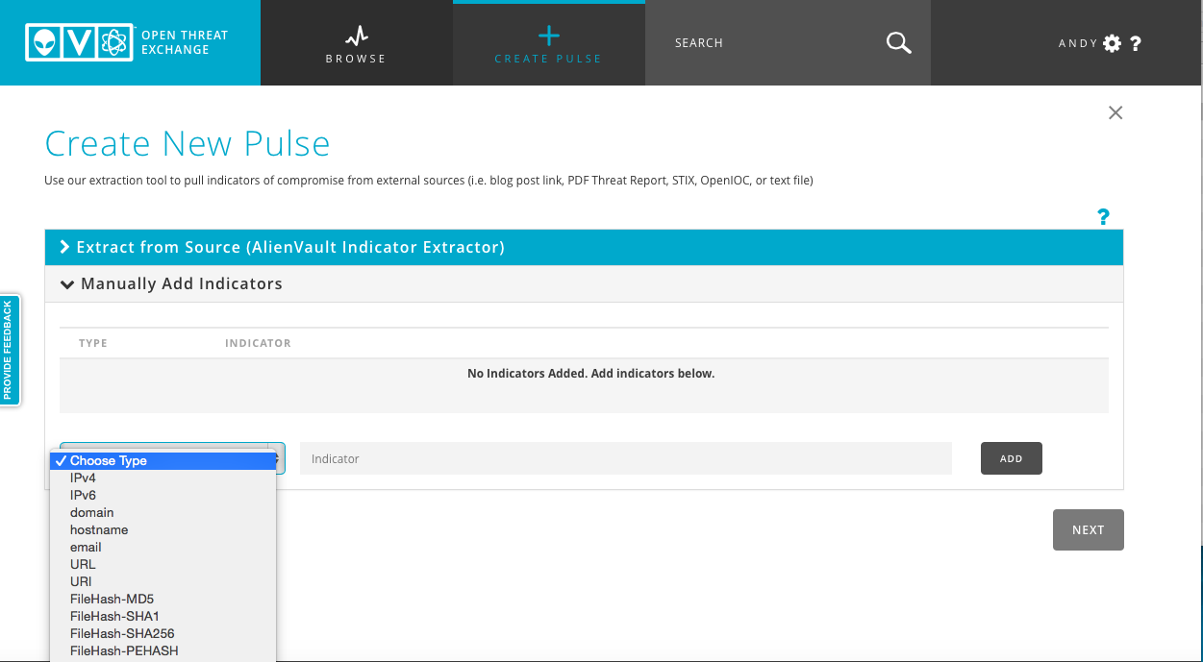
CREATING PULSE
MANUALLY

Slide 21
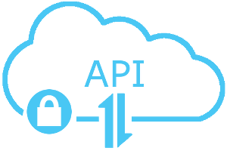

PULSE API:
OPEN ACCESS, OPEN STANDARDS
DirectConnect API
Free access to Java and Python SDKs for pulse data
DirectConnect Agents for popular open source software suites (e.g.: BroIDS) Open Formats
Export pulses to STIX, OpenIoC, CSV

Slide 22
Summary
Effective threat sharing
Crowd-source threat data without attribution
Provide valuable intelligence that can be acted on quickly
Facilitate the collection, validation and dissemination of diverse, crowd sourced threat data
Open, collaborative and affordable
Enable organizations to share threat intelligence with each other in a trusted environment
Should span industries, market categories and geographies

